Slide 1
Immunology case study
Hereditary angioedema
Dr H Awad

Slide 2
Case study: hereditary angioedema
A disease caused by genetic deficiency in C1 inhibitor (C1INH )
C1INH is a serine protease inhibitor (serpin)
It is the sole inhibitor of C1
C1INH also contributes to serine inhibitors of the clotting and kinin system
The main product of the kinin system is bradykinin that causes vasodilation and edema

Slide 3
Hereditary angioedema
A disease caused by a congenital defect in C1INH ( C1 inhibitor)
C1INH is the most potent inhibitor of the classical pathway.
It is a serine protease which inhibits:
1. C1 so it affects the classical complement pathway but not the other pathways. Note that C1INH is the sole inhibitor of C1.
2. Clotting system
3. Kinin
4. Hageman factor ( factor XII)

Slide 4
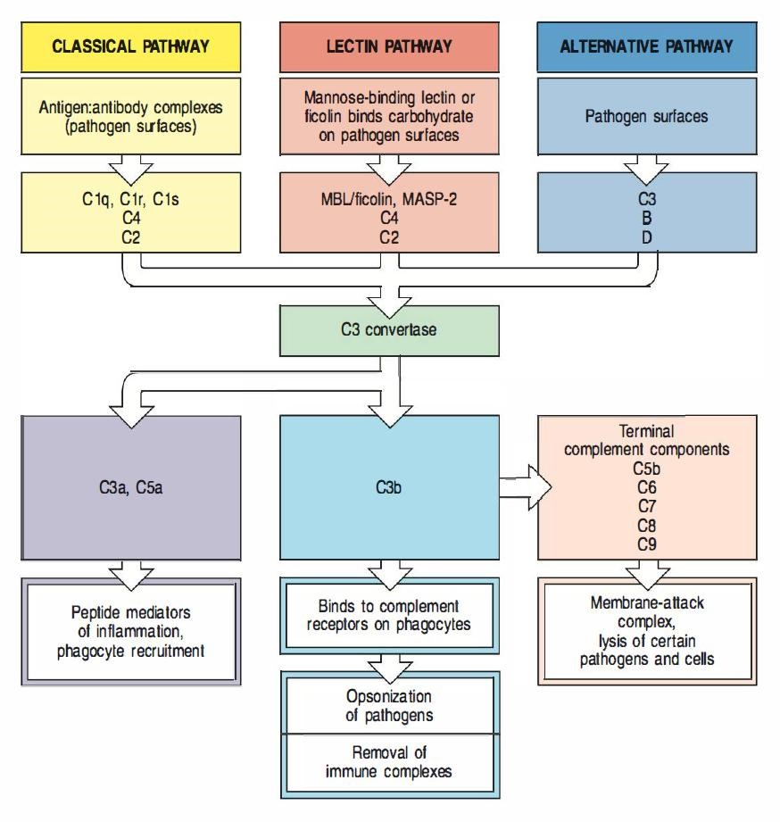
Complement activation note that in hereditary angioedema, only the classical pathway is affected

Slide 5
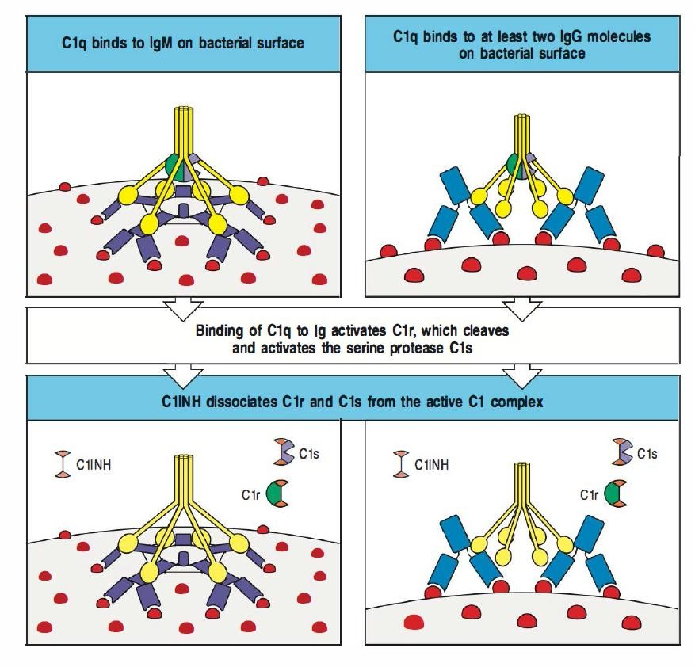
C1INH inhibits C1 preventing formation of C1 complex

Slide 6
C1INH inhibits C1r and C1s
It inhibits them by presenting them to a bait site: which is an arginine bond that they cleave
When they cleave this arginine bond they covalently bind to C1INH and are dissociated from C1q
Remember for the classical pathway activation you need C1qr2s2 complex.
Because C1INH causes dissociation of this complex.. It inhibits the classical pathway of complement activation

Slide 7
Genetic deficiency of C1INH means results in loss of inhibition of the classical pathway
So active complement components are produced and also more bradykinin is produced
The active complement components are C4a ,C4b ,C2a, C2b
These are produced because there is no inhibition of C1.. So there is more C1 complex that can cleave C2 and C4.
The active components will be neutralized as long as there is no infection which means there will not be inappropriate activation of the complement system.
Note that other that C2 and C4 the rest of complement proteins are normal and not affected.
Because C2 and C4 are continuously cleaved there is a decrease in C2 and C4.
More bradykinin means patients will have edema in several parts of their body.

Slide 8
Edema in hereditary angioedema
Swelling in skin, intestine, extremities, face trunk, airway…
Skin and submucosal swelling is not dangerous.. It only causes temporary disfigurement
Swelling of the intestine causes pain ,vomiting and watery diarrhea
Swelling of the larynx is dangerous, it can block the airway and can be life threatening
No itching or hives.. This differentiates it from allergic angioedema
It is not allergic and not related to histamine

Slide 9
Bradykinin is the main mediator responsible for Hereditary angioedema attacks
This is because bradykinin causes vasodilation and increased vascular permeability by causing endothelial cell contraction

Slide 10
Attacks are related to activation of four serine proteases
Factor X11
Plasmin
C1q
C1r

Slide 11
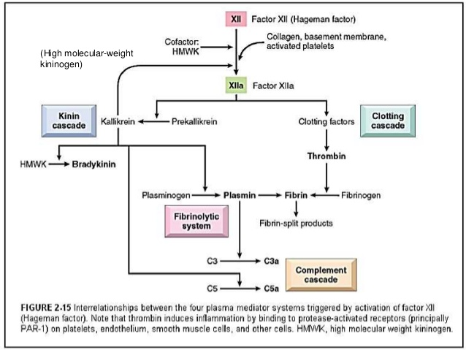
Remember: Hageman factor( factor XII) activates kinin, complement, plasmin and clotting factors.و
Last year… inflammation و الله درستكوا هاذ في ال

Slide 12
Symptoms in these patients are related to bradykinin effect
Treatment:
C1INH
Kallikrin inhibitor
Bradykinin receptor antagonist

Slide 13
note
Although there is decreased C2 and C4, patients are not at increased risk of developing infections because the other complement pathways compensate,

Slide 14
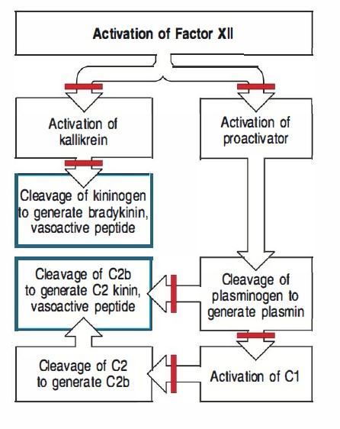

Slide 15
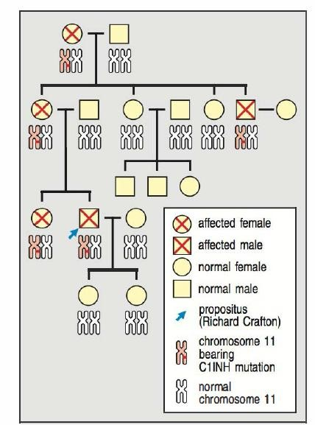
Family tree of a patient with hereditary angioedema showing that the mode of inheritance is autosomal dominant

Slide 16
note
Patients with the disease inherit one defective chromosome
The C1INH laves are decreased. Because one chromosome is normal you might expect the C1INH level should be half the normal
However patients usually have less than 50% of the C1INH
This can be explained by: decreased production from the normal chromosome and increased consumption of C1INH due to icreased C1 activation

Slide 17
That was spoon feeding!!!
Enjoy your meal

