Slide 1
Indoor and outdoor air pollution, and Clean air act
Prof. Madi jaghbir

Slide 2
Indoor Air Pollution - Overview
-People spend most of their time indoors.
-The EPA has shown that indoor levels of some pollutants, such as formaldehyde, and chloroform, range from 2 to 50 times higher than outdoor levels.
-Exposure to pollutants such as environmental tobacco smoke and radon occurs almost entirely indoors.

Slide 3
1. Environmental Tobacco Smoke (ETS)
The EPA has classified environmental tobacco smoke as a class A carcinogen, responsible for approximately 3,000 lung cancer deaths and 62,000 heart disease deaths annually in U.S.
Remedial action: The most effective solution is to eliminate all smoking from the individual’s environment, either through smoking prohibitions or by restricting smoking to properly designed smoking rooms.

Slide 4
2. Heaters, Stoves, Fireplaces
Releases carbon monoxide, nitrogen dioxide and particles
Carbon Monoxide- colorless, odorless gas
Nitrogen Dioxide- colorless, odorless gas
Particles- released when fuels are incompletely burned

Slide 5
3.Biological Contaminants
-Biological contaminants are mold, mildew, bacteria, pet dander, dust mites, and pollen
-Humidity level in the home plays an important role in controlling the environment that some biological contaminants grow and thrive in
-A safe home humidity level is 30-50%

Slide 6
Remedial Action
Provide adequate outdoor air ventilation to dilute human source aerosols.
Keep relative humidity below 50 percent.
Keep equipment water reservoirs clean and potable water systems adequately chlorinated, according to manufacturer instructions.
Maintain humidifiers and dehumidifiers according to manufacturer instructions.

Slide 7
4. volatile organic compound(Formaldehyde, Pesticides, Solvents, Cleaning Agents)
Formaldehyde: has been classified as a probable human carcinogen by the EPA.
Pesticides : some pesticide active ingredients and inert components are considered possible human carcinogens.
Remedial action: Increase ventilation when using products that emit volatile organic compounds.
Formaldehyde: Identify the source, and if possible, remove it. If not possible, reduce exposure.

Slide 8
5.Heavy metals (airborne lead and mercury vapor)
Lead (Pb) is toxic, particularly impacting children (in the form of cognitive and developmental deficits).
The Centers for Disease Control and Prevention has set 10 g/dl (blood lead level (PbB)) as the level of concern.
The chief source is paint.
elevated levels of mercury is found in interior latex paint.

Slide 9
6. Long term risks (radon)
Radon: is the second leading cause of lung cancer, following smoking.
It is present in high concentration in certain types of soil and rocks (e.g. granite)
Since 1988, EPA has recommended that homes below the third floor be tested for radon.
Corrective steps include sealing foundation cracks and holes, and venting radon-laden air from beneath the foundation.

Slide 10
MAJOR OUTDOOR AIR POLLUTANTS
Particulate matter
Ozone
Nitrogen oxides
Carbon monoxide
Sulfur dioxide

Slide 11
1. Particulate matter
Complex mixture of particles that can be solid, liquid or both
Vary in size, composition, and origin
Sources:
Power plants and industry
Motor vehicles, domestic coal burning
Natural sources (volcanoes, dust storms)
Small particles form surface for acid aerosol formation

Slide 12
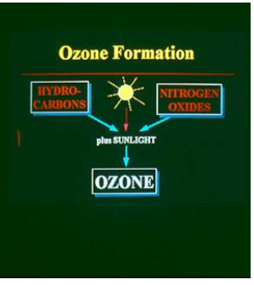
Ozone
“Secondary pollutant"
Formed by photochemical reaction of VOCs, NO2 + O2 Peaks late afternoon Maximum in hot, stagnant air

Slide 13
NITROGEN OXIDES (NOX ):
SOURCES
Power plants, industry
Motor vehicles
Natural sources (volcanoes, lightning, bacteria)

Slide 14
CARBON MONOXIDE (CO):
SOURCES
Incomplete combustion of fuels
Vehicle exhaust
Industry
Fires

Slide 15
SULFUR DIOXIDE (SO2 )
SOURCES
Combustion of sulfur-containing coal or oil
Industrial processes, smelting of sulfur-containing ores
Natural sources (volcanoes)
Combines with water to form H2SO4 (acid aerosol, acid rain)

Slide 16
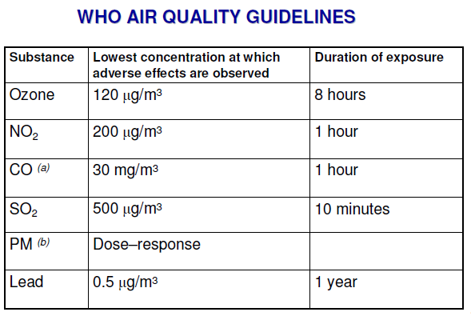

Slide 17
Outdoor Air Pollution Prevention
Implement control mechanisms (emission inspections)
Monitor air quality
Inform the public of effective pollution reduction activities and associated health benefits
Promote the use of clean, renewable energy sources , such as solar and wind-powered energy , and encourage the movement away from dirtier fuels, such as coal
Encourage technological innovation to decrease emissions from stationary sources and conventional vehicles, and investigate alternative fuels

Slide 18
clean air act

Slide 20
Under the clean air act EPA’s sets limits on certain air pollutants including setting limits on how much can be in the air any where in the U.S
The clean air act has helped to cut dangerous pollutants clean up air pollution and production and use of chemicals that contribute to the hole in the ozone layer since 1980

Slide 21
Ground level ozone has reduced by more than 25%
Sulfur dioxide has reduced by 71%
Nitrogen dioxide has reduced by 46%
Lead content in gasoline has reduced by 92% and levels of lead in the air has decreased by 94%

Slide 22
THANK YOU
SOURCES
www.epa.gov/air/caa/requirment.html
https://www.epa.gov/indoor-air-quality-iaq/indoor-air-pollution-introduction-health-professionals-printable-version

