Slide 1
Introduction to pathology Inflammation lecture 1
Dr H Awad
FRCPath
First trimester 2016/17

Slide 2
Contact details
Email: h_awad@ju.edu.jo
Office hors: 11-12 Mondays
Office: third floor , JUH
Lectures will be available on my website page a day before they are delivered.
PLEASE bring a pen and papers to my lectures!!!!

Slide 3
lecture | topics | pages
1 | Overview of inflammation and Vascular changes | 29-34
2 | Cellular events in inflammation | 35-40
3 | Cell derived mediators | 44-50
4 | Plasma derived mediators Morphology of acute inflammation | 50-53 43-44
5 | Chronic inflammation and systemic effects of inflammation | 53-59

Slide 4
Homeworks
With each lecture there is a short, easy homework activity aimed for yoy to test your understanding.
Please try to have a look at the activity… it will help you.

Slide 5
inflammation

Slide 6
How do you define inflammation?

Slide 7
Inflammation Definition
Protective response
involving (1)host cells, (2)blood vessels and (3)chemical mediators ,
intended to
(1)eliminate (a)the initial cause of injury and the (b)necrotic tissue resulting from the insult
(2)initiate repair.

Slide 8
Unintended outcomes!
Inflammation is a protective mechanism….. Not a disease
However… cells and mediators that destroy injurious agents can destroy normal tissue.

Slide 9
Self control
Inflammation is controlled and self limited.
Inflammatory cells are short lived, and degraded or become inactive.
Anti inflammatory mediators.

Slide 10
Inflammation is a battle between our tissues and invaders ( injurious agents)
Local tissue damage in inflammation is the collateral damage in war!
War has to stop when its goals are achieved… inflammation is self-limited.

Slide 11
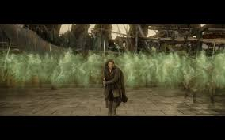
Think of inflammation as a battle

Slide 12
Causes of inflammation any cause of cell injury
Infections
Trauma
Physical : thermal injury, burns
Chemicals
Tissue necrosis: ischemia or physical insult
Foreign bodies
Immune reaction

Slide 13
Inflammation.. ITIS
Tonsillitis
Apendicitis
Pancreatitis
Liver…?
Lung..?

Slide 14
Signs of inflammation
Calor ……. hotness
Rubor …….. redness
Tumor…….. swelling
Dolor……… pain
Functio laesa.. Loss of function

Slide 15
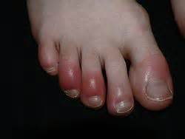
Signs of inflammation

Slide 16
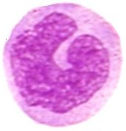
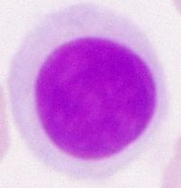
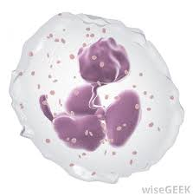
Overview of inflammation

Slide 17
overview
Whiteboard activity!!

Slide 18
Inflammation.. overview
Injurious agent recognized by inflammatory cell ( in blood or tissue)
this inflammatory cell releases chemical mediators that recruit other troops ( cells)
The activated cells also release mediators.
Blood vessels respond to inflammatory mediators by vasodilation and increased permeability.

Slide 19
Vasodilation… causes hyperemia… redness
Vasodilation .. Blood which has a temperature more than skin ( core body temp) is increased in the inflamed area.. Hotness.
Increased permeability.. Movement of fluids from blood to extracellular spaces .. Tissue edema.. Swelling
Swelling affects nerve endings in tissues .. Become more sensitive.. Pain
Loss of function… partly caused by pain.

Slide 20
NOTE..
Hotness is different from fever.
Hotness is localized to the inflammatory site and is caused by vasodilation.
Fever is a systemic manifestation of inflammation caused by several mediators mainly prostaglandins.
Hotness is a cardinal sign of inflammation, fever is not!

Slide 21
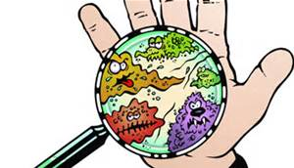
Infection versus inflammation
What are the differences????

Slide 22
Infection is one of the causes of inflammation.
Infection is caused by a pathogen.
Inflammation is the protective response caused by many causes including infections.

Slide 23
Acute versus chronic
Acute: rapid onset, short duration, fluid and plasma protein exudation, predominantly neutrophils.
Chronic: insidious onset, longer duration ( days to years), lymphocytes and macrophages, vascular proliferation and fibrosis.

Slide 24
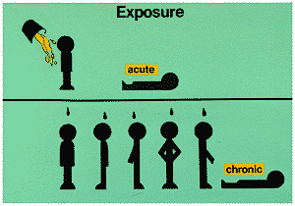
Acute versus chronic

Slide 25
Acute versus chronic inflammation
feature | acute | chronic
onset | Fast: Minutes to hours | Slow: days
cells | neutrophils | Lymphocytes & macrophages
Tissue injury and fibrosis | Mild and self limited | Severe, progressive
Local and systemic signs | prominent | May be subtle

Slide 26
First step in inflammation
Recognition of injurious agent.

Slide 27
Recognition of injurious agent
Receptors on several cells recognize injurious agents.
These receptors present on macrophages, dendritic cells , epithelial cells and others.
These receptors are called pattern recognition receptors because they recognize structures common to many microbes or dead cells.

Slide 28
Pattern recognition receptors
Two families:
Toll like receptors… microbial pattern recognition receptors
Inflammasomes…. Recognize products of cell death.

Slide 29
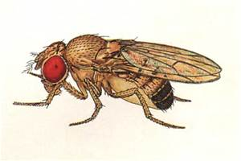
Toll like receptors
First discovered in drosophila
What does toll mean??

Slide 30
Toll like receptors
Microbial sensors.
10 mammalian types:
Can recognize bacterial products : endotoxins, lipopolysaccharides or DNA.
Can recognize viral products: RNA
They recognize a pattern: e:g liposaccharides in general, not a specific type, DNA chains not specific sequences.

Slide 31
Toll like receptors
Located on plasma membrane and endosomes.
So: can recognize extracellular and ingested microbes.

Slide 32
Toll like receptors
Once they recognize the microbe… transcription factors activation… which stimulate production of chemical agents (inflammatory mediators)

Slide 34
Inflammasome
Multi-protein cytoplasmic complex.
Recognizes products of dead cells… uric acid, extracellular ATP, crystals, some microbes..
When stimulated, inflammasome activates caspase 1.
Caspase 1.. Cleaves and thus activates IL- 1 which is a potent mediator.

Slide 35
Inflammasome in action
1)Gout
Urate crystals deposited in joints.. Ingested by macrophages.. Activate inflammasome… IL 1 production… inflammation
2)Inflammasome stimulated by cholesterol crystals.. Possible role of inflammasome in atherosclerosis.
3) Also activated by free fatty acids in obese people… development of type 2 DM.
???TREATMENT BY blocking IL 1

Slide 36
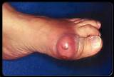
gout

Slide 37
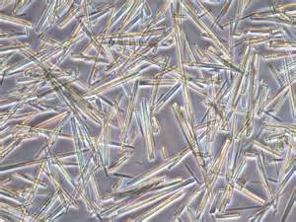
Uric acid crystals

Slide 38
homework
Case study about gout
Refer to my web page .

