Slide 1
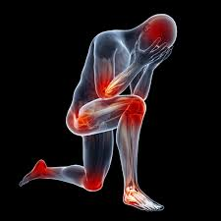
Inflammation-3
Manar Hajeer, MD, FRCPath

Slide 2
CHEMICAL MEDIATORS AND REGULATORS OF INFLAMMATION

Slide 3
Inflammatory mediators
Cell derived : Produced locally by cells at the site of inflammation (histamine, PGs).
OR
Plasma protein derived : Derived from circulating inactive precursors (from liver) that are activated at the site of inflammation (complement, kinins).

Slide 4
General principles…
Act by binding to receptors,,, on different target cells.
May act on only one or a very few cell types, or they may have diverse actions.
Some mediators (e.g., lysosomal proteases, ROS) have direct enzymatic and/or toxic activities.
The actions of most mediators are tightly regulated and short-lived (spontaneous decay, inactivation, elimination or inhibition) .

Slide 5
Quick decay (e.g., arachidonic acid metabolites)
Enzymatic inactivation (e.g., kininase inactivates bradykinin)
Elimination (e.g., antioxidants scavenge toxic oxygen metabolites),
Inhibition (complement-inhibitory proteins)

Slide 6
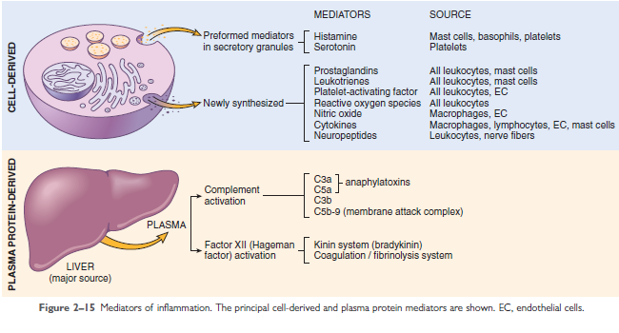

Slide 7
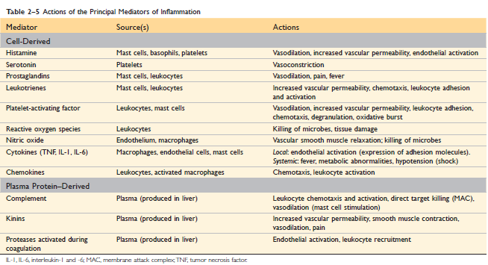

Slide 8
Cell-Derived Mediators
Derived from:
1-Tissue macrophages.
2-Mast cells.
3-Endothelial cells.
4-Leukocytes.

Slide 9
Vasoactive Amines Histamine and serotonine
Histamine:
Source: Mast cells,,,, basophils and platelets.
Stimuli for release:
(1) Physical injury .
(2) Immune reactions (IgE mediated)
(3) C3a and C5a (anaphylatoxins)
(4) Histamine-releasing proteins.
(5) neuropeptides (e.g., substance P)
(6) Certain cytokines (e.g., IL-1, IL-8).

Slide 10
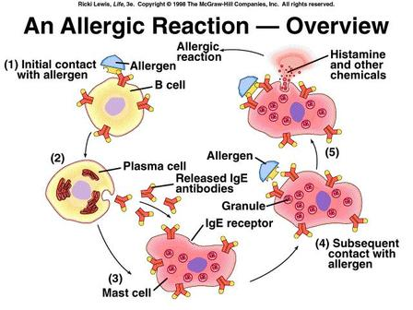

Slide 11
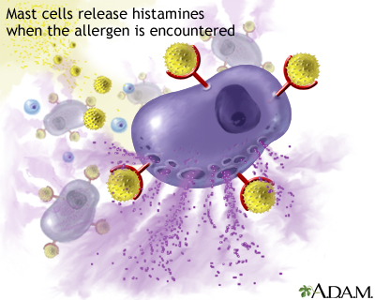
Actions :
Vasodilation.
Increased vascular permeability
Endothelial activation
HISTAMINASE ?????

Slide 12
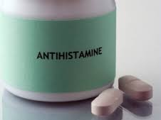

Slide 13
Serotonin
Source: Platelet granules.
Actions: vasoconstriction during clotting, neurotransmitter.

Slide 14
Arachidonic Acid Metabolites SOURCES OF AA

Slide 15
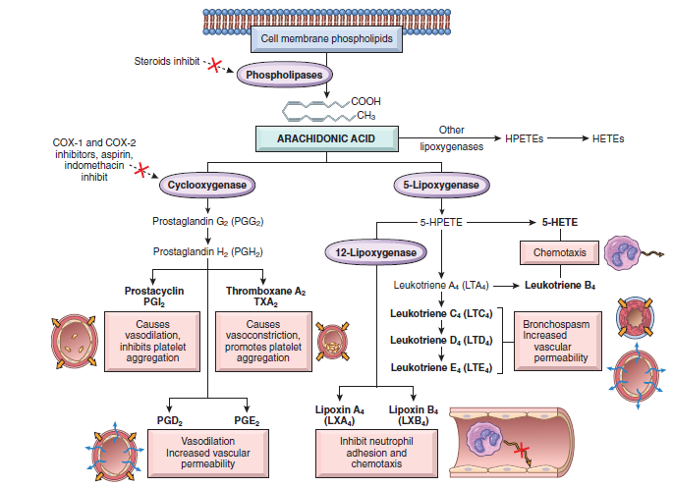
Arachidonic Acid Metabolites: Prostaglandins, Leukotrienes, and Lipoxins

Slide 16
Two major enzymatic pathways:
1-Cyclooxygenase pathway:
Produces prostaglandins and thromboxanes,
2-Lipoxygenase pathway:
produces leukotrienes and lipoxins

Slide 17
Prostaglandins and thromboxanes
PGE2, PGF2α .
PGD2 (in mast cells)
PGI2 (prostacyclin) in endothelial cells.
Thromboxane A2 (in platelets)
Opposing roles of PGI2 and TXA2 (prostacyclin synthase in endothelial cells and thromboxane synthase in platelets)

Slide 18
Actions :
TXA2, platelet-aggregation and vasoconstriction.
PGI2: vasodilator and inhibitor of platelet aggregation
PGD2 along with PGE2 and PGF2α: vasodilation and edema formation.
PGE2: pain and fever.

Slide 19
Thromboxane A2 | prostacyclin
Produced in platelets | Produced in endothelial cells
vasoconstrictor | vasodilator
Stimulate platelet aggregation | Inhibit platelet aggregation

Slide 20
Leukotrienes
LTA4, LTB4, LTC4, LTD4, and LTE4.
LTB4:
Source:neutrophils and macrophages
Actions: chemotactic agent for neutrophils.
LTC4, LTD4 and LTE4:
Source: mast cells
Actions: bronchoconstriction, vasoconstriction and increased vascular permeability

Slide 22
Lipoxins.
Anti-inflammatory mediators
Produced in tissues
From leukocytes and platelets
Inhibit neutrophil chemotaxis and adhesion to endothelium
Endogenous antagonists of leukotrienes

Slide 23
Anti-inflammatory Drugs That Block Prostaglandin Production
NSAIDs (aspirin and ibuprofen) inhibit cyclooxygenase activity, blocking all prostaglandin synthesis
Used to treat pain and fever.
COX-1 and COX-2.
COX-1 constitutively expressed in most tissues (protective actions, stomach and kidney).
COX-2 is induced by inflammatory stimuli.
COX-2 inhibitors are selective ( but risk of cardiovascular and cerebrovascular events, how?!!)

Slide 24
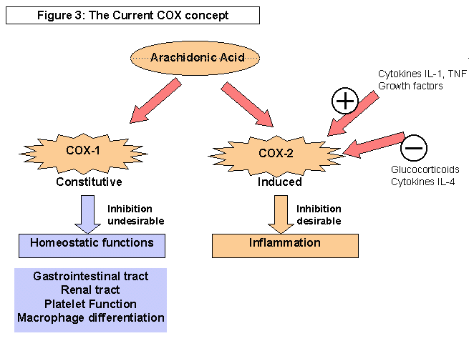

Slide 26
Glucocorticoids
Powerful anti-inflammatory agents.
Inhibit phospholipase A2
Block release of AA from membrane phospholipids.

