Slide 1

Health Care Systems
Dr. Sireen Alkhaldi, BDS, MPH, DrPH
Community Health / First Semester 2014/2015
Department of Family and Community Medicine
Faculty of Medicine/ The University of Jordan

Slide 2
Learning Objectives of this lecture:
By the end of this lecture, you are going to:
1. Understand the definition and, elements, and components of a health care system.
2. Identify the goals of health systems.
3. Describe the components of health care delivery system.
4. Describe the Jordan health system, organization, financing, and expenditures.

Slide 3
What is a Health Care System?
What is a System?
System: “a set or arrangement of things connected or related to form a unity or organic whole”.
System: “a collection of components organized to accomplish a specific function or a set of functions”.
The parts of a system can be referred to as its elements or components
The environment of the system is defined as all of the factors that affect the system and are affected by it.

Slide 4
What is a Health Care System?
A Health Care System: “the complete network of agencies, facilities, and all providers of health care in a specified geographic area.”
(Mosby's Medical Dictionary, 8th edition. © 2009, Elsevier.)

Slide 5
What is a Health Care System?
The term is usually used to refer to the system or program by which health care is made available to the population and financed by government, private enterprise, or both.

Slide 6
What is a Health Care System?
Every country has a health system, however fragmented it may be among different organizations or however unsystematically it may seem to operate.
Integration and oversight do not determine the system, but they may greatly influence how well it performs.

Slide 7
Health Care Systems
Health care systems are designed to meet the health care needs of target populations.
In some countries, the health care system has evolved and has not been planned, whereas in others efforts have been made by governments, trade unions, charities, religious, or other co-ordinated bodies to deliver planned health care services targeted to the populations they serve.

Slide 8
Goals of a Health Care System
The goals for health systems, according to the World Health Report (WHO, 2000), are:
Good health (improving health)
Responsiveness to the needs and expectations of the population
Fair financial contribution.
Efficient to achieve the best outcomes possible given available resources and circumstances

Slide 9
What is a Health Care Delivery System?
Three major components that make up the Health Care Delivery System are:
Facilities
Practitioners
Entities

Slide 10
Health Care Facilities
Hospitals: acute and sub-acute care, primary care, and tertiary care (medical education and complex cases)
Ambulatory Surgery Health Centers (out-patient)
Skilled Nursing Facilities
Home Health Agencies: nursing care at home
Freestanding Substance Abuse Facilities: inpatient
Hospice: care for terminally ill patients

Slide 11
Practitioners
Physicians
Medical Doctors (MD)
Nurses
Nurse Practitioners
Registered Nurse (RN)
Physician Assistants (PAs)
Therapists
Physiotherapist (PT)
Occupational therapist (OT)
Speech therapist (ST)

Slide 12
Entities
Provide the financial and regulatory functions for the facilities and practitioners, e.g. government.

Slide 13
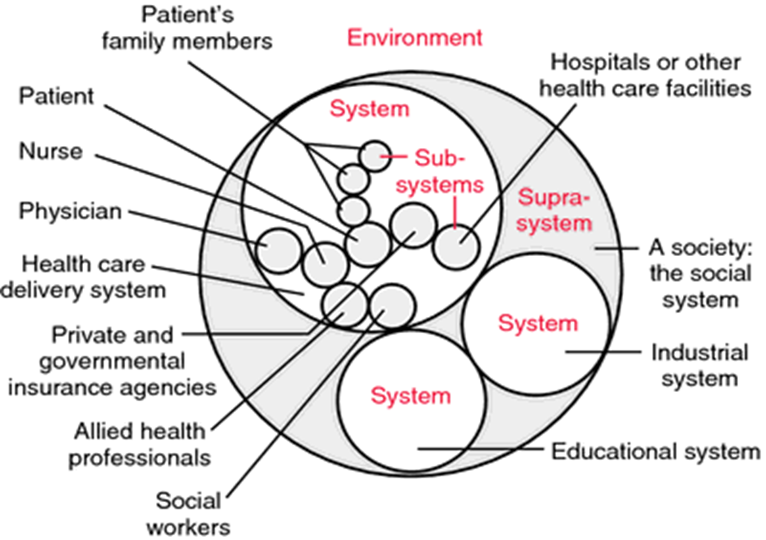
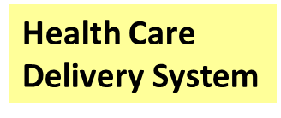

Slide 14
Elements of a health care system
The elements of a health care system embrace the following:
Personal health care services for individuals and families, available at hospitals, clinics, neighborhood centers, and in physicians' offices, etc…… .
Public health services needed to maintain a healthy environment, such as control of water and food supplies, regulation of drugs, and safety regulations.
Teaching and research activities related to the prevention, detection, and treatment of disease.
Third party (health insurance, pharmaceutical companies) coverage of system services.

Slide 15
Key components of a well functioning health system
Health System Building Blocks
The building blocks alone do not constitute a system, any more than a pile of bricks constitutes a functioning building.
It is the multiple relationships and interactions among the blocks – how one affects and influences the others, and is in turn affected by them – that convert these blocks into a system.

Slide 16
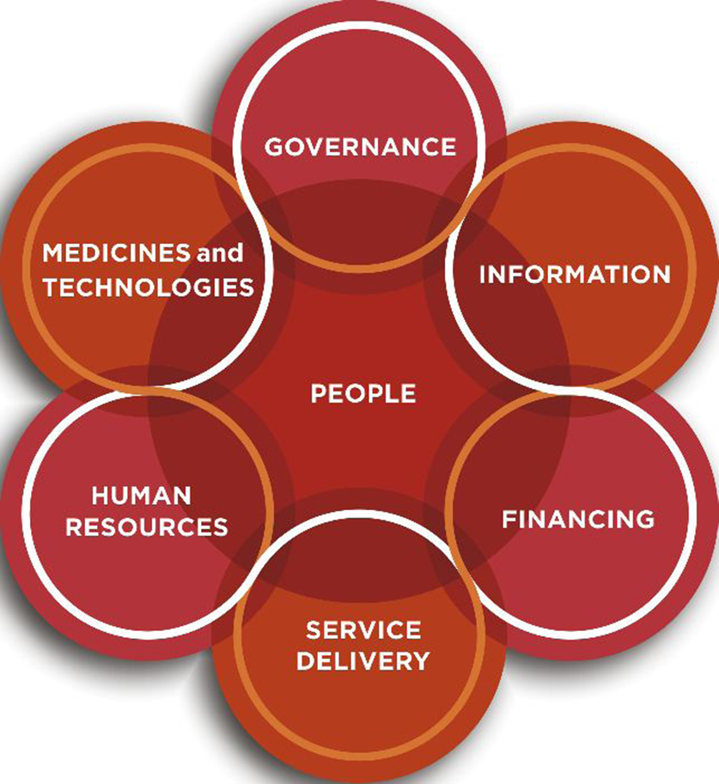
Key components of a well functioning health system
Figure 1.2 The dynamic architecture and interconnectedness of the health system building blocks

Slide 17
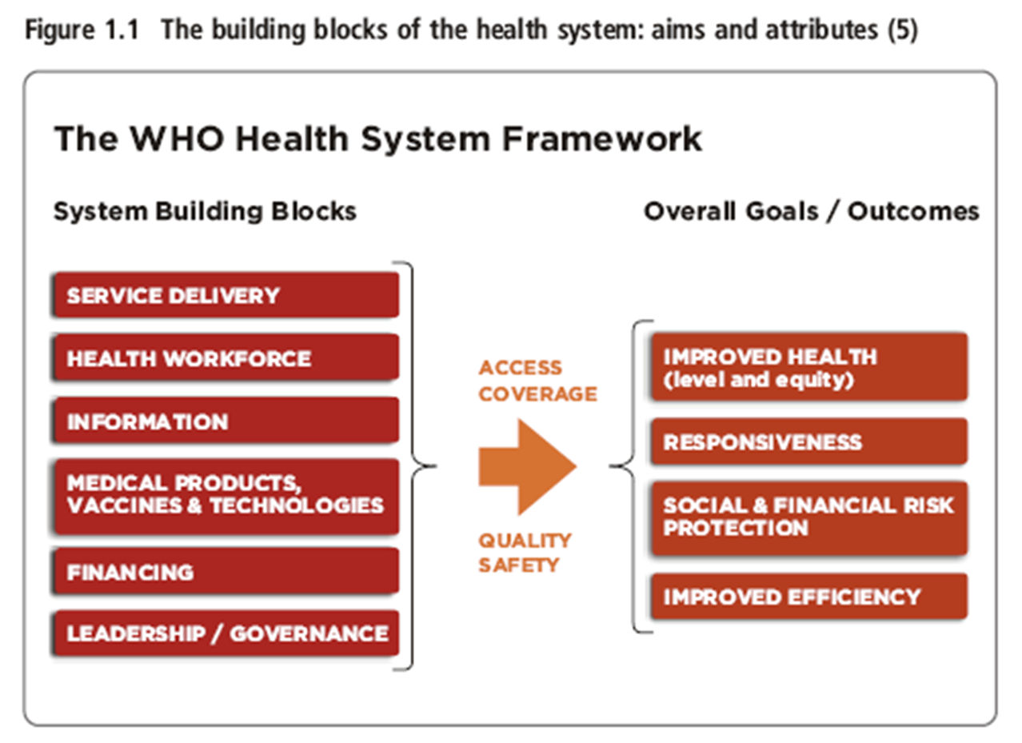

Slide 18
Health System in Jordan
How it is organized….
Jordan has one of the most modern health care infrastructures in the Middle East.
Jordan’s health system is a complex amalgam of three major sectors: Public, private, and donors. The public sector consists of two major public programs that finance as well as deliver care: the Ministry of Health (MOH) and Royal Medical Services (RMS).
Other smaller public programs include several university-based programs, such as Jordan University Hospital (JUH) in Amman and King Abdullah Hospital (KAH) in Irbid.

Slide 19
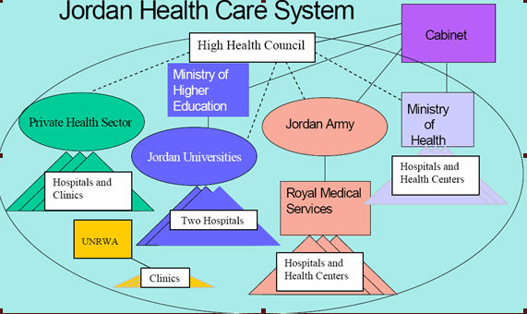

Slide 20
Overall Health Care System in Jordan
The public sector :
1. MOH
2. Royal Medical Services
3. Jordan University Hospital
4. King Abdullah Hospital
5. United Nation Relief Works Agency (UNRWA)
The Private sector:
1. Not – for Profit Hospitals : runs 9 hospitals
2. Private Hospitals :49 hospitals

Slide 21
Jordan Health Care System
Ministry of Health: is the major institution financer and provider of health care services in Jordan.
  (MOH) provides primary, secondary and tertiary health care services.
  Primary Health Care services are mainly delivered through an extensive primary health care network consisting of :
    84 comprehensive health centers
    368 primary health care centers
    227 village Clinics
    422 MCH Centers and 369 oral health clinics.

Slide 22
Insured population in Jordan

Slide 27
Why Study Health Systems?
Health systems are one of the several determinants of health, and high-performing health systems can improve the health of populations.
The way Health Systems are designed, managed, and financed affects people’s lives and livelihoods.
Preventable deaths and disability is disproportionately borne by the poor.
Responsibility of health system performance lies on the government.

Slide 28
Why Study Health Systems?
The difference between a well-performing health system and one that is failing (falling short of their performance potential) can be measured in death, disability, impoverishment, humiliation and despair.
In the Health Systems perspective we get out of the “health” box, in thinking that only medical services and technologies are important; rather, in Systems perspective, we address inequalities in income and housing, seatbelt laws, safe roads, antismoking legislation, firearm legislation, workplace safety all help to maintain good health.

Slide 29
Levels of Health Care
One concept is essential to understanding the “topography” of any health care system, is the organization of care into primary, secondary, and tertiary levels.

Slide 30
1. Primary Care:
Primary Care is the usual point at which an individual enters the health care system.
It involves common health problems (eg, sore throat, sprained ankle, or hypertension) and preventive measures (e.g., vaccinations) that account for 80%-90% of visits to a physician or other caregivers.
Its major task is the early detection and prevention of disease. This level of care contains the routine care of individuals with common health problems and chronic illnesses that can be managed in the home or through periodic visits to an outpatient facility.

Slide 31
Primary care, cont.
Care givers at this level are general practitioners (PG’s) who’s main responsibility is ambulatory care.
They can be located in community and neighborhood health centers, hospital outpatient departments, physicians' offices, and school and college health units.

Slide 32
2. Secondary or acute care
It involves problems that require more specialized clinical expertise. Entry into the system at this level is either by direct admission to a health care facility or by referral.
Providers in this level are physicians in specialties such as internal medicine, pediatrics, neurology, psychiatry, obstetrics and gynecology, and general surgery.
Secondary-level physicians are located at hospital-based clinics and they provide care to hospitalized patients.

Slide 33
3. Tertiary Care:
Includes highly specialized technical services for the treatment of rare complex diseases.
Providers of tertiary care are sub-specialists in a particular clinical area such as cardiac surgeons, immunologists, and pediatric hematologists .
They are located at a few tertiary care medical centers and highly specialized units of general hospitals; for example, a coronary care unit.
Entry into the health care system at this level is gained by referral from either the primary or secondary level.

Slide 34
Two contrasting approaches…
Two contrasting approaches can be used to organize a health care system around these levels of care:
(1) The carefully structured regionalized health care (The Dowson Model).
(2) A more free-flowing model.

Slide 35
1. The Highly Structured System
(the Dowson model)
It is based on the concept of regionalization:
The Organization and coordination of all health resources and services within a defined area.
This model emphasizes the primary care base. This model is typical for the British National Health Services (NHS), most European countries, and health maintenance organizations (HMO’s) in the United States.

Slide 36
Patient Flow in the Highly Structured System
Patient flow moves in a stepwise fashion across the different levels. Except in emergency situations.
All patients are first seen by GP’s, who may then steer the patients toward more specialized levels of care through a formal process of referral. This is called Gatekeeping.
Patients may not refer themselves to a specialist.
GP’s comprise two-thirds of physicians in the UK.

Slide 37
The Structured Model: Planning with population focus
Planning of physicians and hospital resources occurs with a population focus:
GP groups follow the primary-secondary-tertiary care structure and provide care to a population of 5000-50,000 persons, depending on the number of GP’s in the practice.
District hospitals are local facilities equipped for basic inpatient services, and have a catchment area population of 50,000 – 500,000 persons.
Tertiary care hospitals serve as a referral centers and handle highly specialized inpatient care needs for a population of 500,000 – 5 million persons.

Slide 38
2. The Free-Flowing Model
An alternative model allows for more fluid roles for caregivers, and more free-flowing movement of patients, across all levels of care.
This model tends to place higher value on services at the tertiary care than at the primary care base.
This is a more dispersed, fragmented structure of health care, which is typical for the United States health care system.

Slide 39
The Free-Flowing Model
Insured patients in the United States are traditionally able to refer themselves and enter the system directly at any level.
Instead of having a designated primary care physician (PCP), patients in the US are used to taking their symptoms directly to the specialist they choose.
Physicians in the US have less clear defined roles.
Only 13% of physicians in the US are general or family practitioners.

Slide 40
Which Model is Right?
The structured model is characterized with:
Continuity of care: sustaining a patient-caregiver relationship over time, which is associated with greater use of preventive services (eg, regular source of care results in better control of hypertension and less reliance on emergency care).
Comprehensiveness: the ability of the GP to manage a wide range of health care needs, in contrast to specialty care which focuses on a particular organ.
Coordination: through referral and follow-up, the primary care provider integrates services delivered by other caregivers.
Patient satisfaction and better patient outcomes, as a result of compliance with medications, and reduced hospitalization and decline of overall costs.

Slide 41
Which Model is Right?
The Free-Flowing model is partially blamed for the high cost of health care in the US, and quality of care also suffers.
(eg, when many hospitals perform small numbers of surgical procedures such as coronary artery bypass grafts, mortality rates are higher than when such procedures are regionalized in a few higher-volume canters).
This is due to the less integrated care.
On the other hand, the Free-Flowing model promotes flexibility and convenience in the availability of facilities and personnel. The emphasis on specialization and technology is compatible with values and expectations in the US (patients value direct access to specialists and autonomy in selecting caregivers).

Slide 42
Which Model is Right?
International comparisons of health systems have indicated that nations with greater primary care orientation tend to have more satisfied patients and better performance on health indicators such as infant mortality and life expectancy.
Within the US, states with greater supply of primary care physicians, but not specialists, have lower mortality rates.

Slide 43
