Slide 1
Neoplasia lecture4
Dr Heyam Awad
FRCPath

Slide 2
Molecular basis of cancer
Neoplasms are caused by nonlethal, genetic damage, which causes uncontrolled cellular proliferation.
Nonlethal: so cells can still multiply!
Genetic damage: mutations or non-mutational damages (epigenetic changes)
uncontrolled proliferation… not all genetic damages produce tumors, they only do so if they result in a crazy cell that can multiply continuously in an uncontrolled, uninhibited fashion!

Slide 3
Tumor clonality
Because tumor cells originate from one single genetically damaged crazy cell…. They are clonal
What does a clone mean?
Note: tumors start as a clone, but with time they acquire several mutations in some of the cells.. They become heterogeneous. This is because some cells develop mutations that make them acquire characteristics like: ability to invade, to metastasize.. etc

Slide 4
Genetic damages in neoplasms
These need to be damages causing changes in cell proliferation
So: four types of regulatory genes are mainly affected:
1. growth promoting proto-oncogenes
2. growth inhibiting tumor suppressor genes
3. genes that regulate apoptosis
4. genes involved in DNA repair.

Slide 5
oncogenes
Normally: our cells have proto-oncogenes. These cause cell proliferation in a regulated manner
If the proto-oncogenes are mutated or overexpressed: they are called oncogenes
Proto-oncogenes encode for proteins: proto-oncoproteins, or oncoproteins
These oncoproteins include: transcription factors, growth regulating proteins, proteins involved in cell survival.

Slide 6
oncogenes
Oncogenes cause overexpression of proteins involved in cell growth.
If one allele is mutated or overexpressed: there will be increase in the growth proteins
So oncogenes are dominant .
Important oncogenes : RAS and ABL

Slide 7
How oncogenes overexpressed??
1. point mutation resulting in activation
2. amplification : increased number of copies of the oncogenes
3. translocations
4.Epigenetic modification
Details will follow . Don’t worry

Slide 8
Tumor suppressor genes
They normally inhibit cell growth
If mutated or lost: loss of growth inhibition : so tumor
Both alleles need to be lost or mutated for the tumors to develop…. Because if only one allele is lost , the other can compensate!
So they are recessive genes
in some cases loss of one allele is enough for transformation… haploinsufficiency ( see next slide for definition)

Slide 9
Haploinsufficiency: A situation in which the total level of a gene product (a particular protein) produced by the cell is about half of the normal level and that is not sufficient to permit the cell to function normally.
Another way to define haploinsufficiency is as a condition that arises when the normal phenotype requires the protein product of both alleles, and reduction of 50% of gene function results in an abnormal phenotype

Slide 10
Tumor suppressor genes
Most important examples:
1. RB gene(retinoblastoma gene) .. Governor: controls growth and puts a brake in cellular proliferation
2. TP53 gene … guardian of the genome… sense genetic damage. So if there is damage it causes cessation of proliferation or if the damage cannot be repaired it causes apoptosis.

Slide 11
TP53
Mutations in TP53 do not directly transform cells. They permit and accelerate acquisition of mutations in oncogenes or tumor suppressor genes.
Same rule applies for mutations in genes that are responsible for DNA repair
Ability of a cell to accumulate mutations = mutator phenotype

Slide 12
note
Genes that regulate apoptosis or DNA repair may be dominant or recessive.

Slide 13
Note
TP 53 is present on chromosome 17p ( note the p in both and note that 5+3=1+7
If you don’t like the comment above.. Ignore it !!!!
By the way , RB is present on chromosome 13q

Slide 14
Genetic lesions in cancer
Mutations or nonmutational
Mutations: 1.subtle: point mutations, insertions, deletions
:or2. large, karyotypic change: translocations, deletions, gene amplification, aneuploidy
Non mutational: MicroRNAs and epigenetic modifications

Slide 15
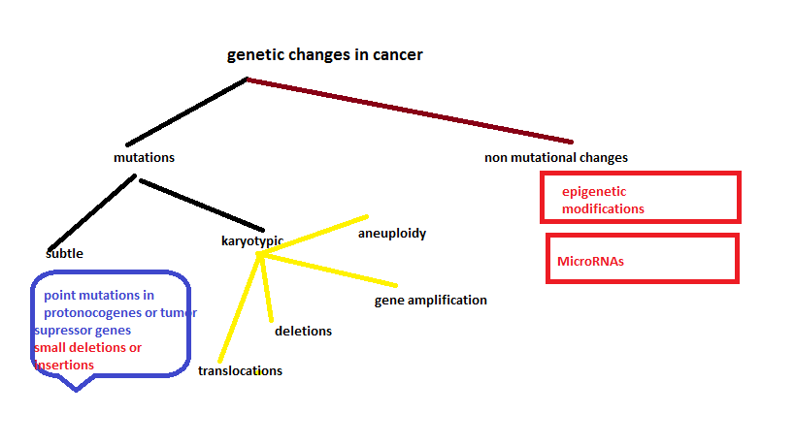
Genetic lesions in cancer

Slide 16
Balanced translocations
Translocations can cause cancer if they increase expression of a proto-oncogene.
This can happen by two mechanisms:
1. removing the proto-oncogene from its normal, regulated locus to a new position where it becomes under influence of a highly active promoter.
2. translocation forms a new fusion gene that encodes a novel protein.

Slide 17
translocations
Occur mainly in haematogenous neoplasms ; why ??
Because lymphoid cells make DNA breaks during antibody or T cell receptor recombination. ( loads of cutting and rearrangements of the genes… so there is more chance that a gene that was cut will be “pasted “ in a new locus!

Slide 18
Tumor type | translocation | Oncogene affected | mechanism | notes
BURKITT lymphoma | t(8;14) | MYC | MYC becomes under stimulation of heavy chain gene elements | 90% of Burkitt cases have the mutation overexpression
Follicular B cell lymphoma | t(14,18) | BCL2 (antiapoptotic) | Overexpression of BCL2 by immunoglobulin gene elements | overexpression
Chronic myelogenous leukemia (CML) | t(9;22) | BCR-ABL rearrangement | New fusion gene ( Philadelphia chromosome) | 90% of cases. More details on next slide!
Ewing sarcoma | t(11;22) | EWS – Fli 1 fusion | Fusion gene | EWS is a transcription factor Fusion product
Prostate carcinoma |  | ETS | Fusion gene
Lung cancer |  | ALK | Fusion gene causing activation of ALK kinase | Only 4% of lung tumors have this fusion…these respond to ALK kinase inhibitors

Slide 19
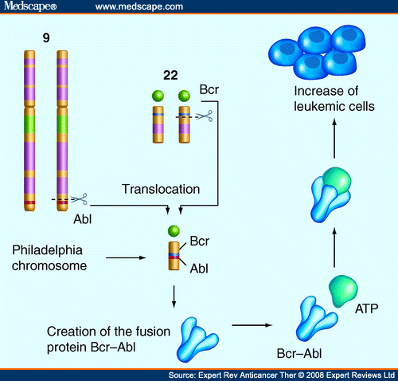
Philadelphia chromosome

Slide 20
deletions
More in non-hematopoietic solid tumors
Second most common karyotypic abnormality.
Result in loss of tumor suppressor gene
2 copies of the tumor suppressor gene need to be lost, usually one by point mutation and another by deletion
Deletions result in loss of heterozygosity (LOH).
Deletions in 13q14. site of RB gene
Deletions of 17p… TP53.

Slide 21
Gene amplifications
Proto-oncogenes can be amplified and overexpressed .. Converted to oncogenes.
Two patterns :homogenously stained region
:Double minutes
Exampl:1. NMYC amplification in neuroblastoma , 25-30% of neuroblastoma cases have the amplification and it is associated with poor prognosis
2. ERBB2= HER2/NEU amplification in 20% of breast cancer. Antibodies against the protein receptor effective in treatment

Slide 23
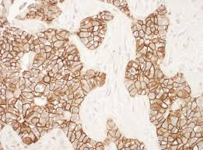
HER2 in breast cancer. Can be detected by immunostain please chech lecture 4 activity for details

Slide 24
aneuploidy
= number of chromosomes not multiple of the haploid state (23).
Result from errors of the mitotic checkpoint
Aneupolidy.. Cause or result of neopalsia?

Slide 25
microRNAs (miRNAs)
Noncoding, micro (22 nucleotides) that are negative regulators of the genes.
They inhibit gene expression post-transcriptionally = repress translation or cleave mRNA.

Slide 26
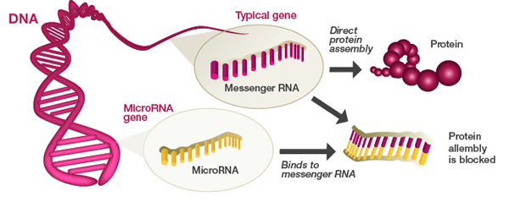
miRNAs

Slide 27
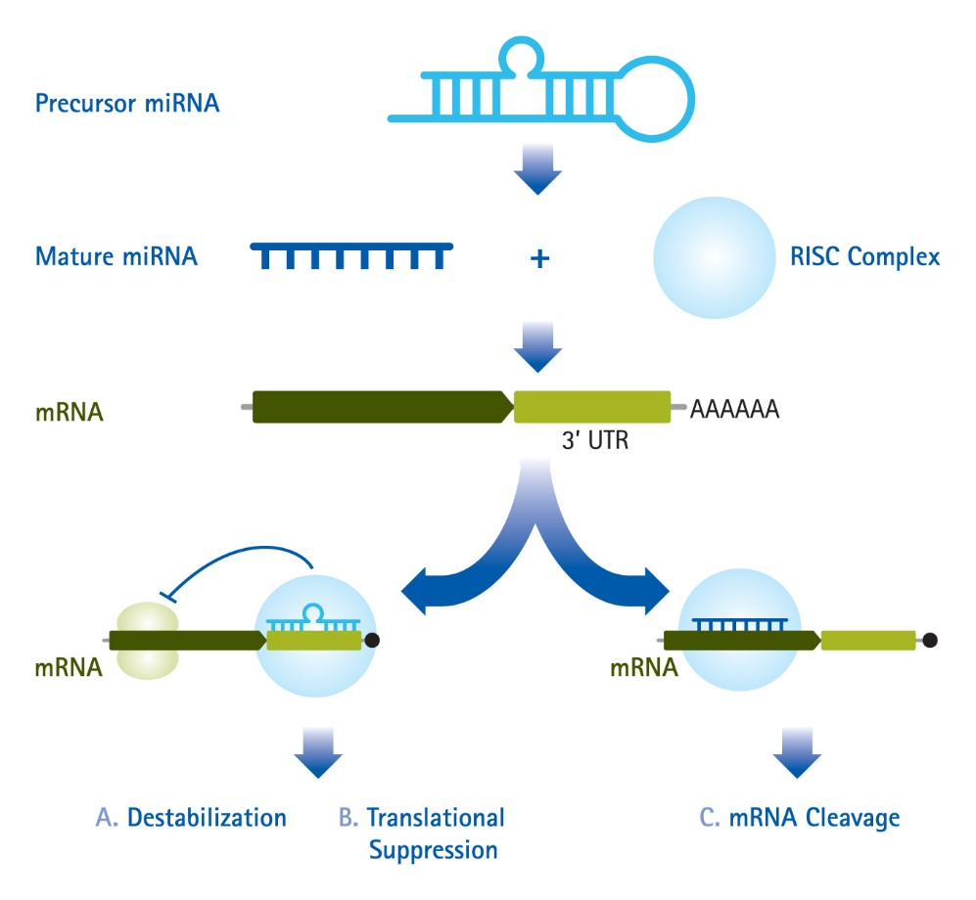

Slide 28
miRNAs that target oncogenes…. If reduced, then inhibition lost…. Overexpression of oncogenes..ras in lung carcinoma and myc in some leukemias
miRNAs that target tumor suppressor genes… if increased… downregulation of tumor suppressor genes.

Slide 29
miRNA
Cause cancer by increasing oncogene expression or decreasing tumor suppressor gene expression.

Slide 30
epigenetics
the study of changes in organisms caused by modification of gene expression rather than alteration of the genetic code itself
Epigenetics are reversible, heritable changes in gene expression that occur without mutation.

Slide 31
Epigenetic modifications
Reversible , heritable changes in gene expression without mutation.
Two types: Histone modifications and DNA methylation.

Slide 32
Epigenetic mutations
functionally relevant changes to the genome that do not involve a change in the nucleotide sequence. Examples of mechanisms that produce such changes are DNA methylation and histone modification, each of which alters how genes are expressed without altering the underlying DNA sequence.

Slide 33
Epigenetics and cancer
Gene expression is silenced by DNA methylation= more methyl groups more silencing.
In cancer cells:
1.Global DNA hypo methylation : increases expression of genes.also causes chromosomal instability
2.Selective promoter hyper methylation of tumor suppressor genes: silenced

Slide 34
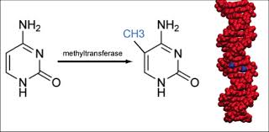

Slide 35
NOTE
Some epigenetic modifications can result from mutations of DNA sequences (gens) that regulate epigenetic modifications!!!!!

Slide 36
Because epigenetic modifications regulate gene expression.. They might affect the response of one gene in different cells.
E.g NOTCH1 gene in oncogenic in T cell leukemia but is tumor suppressor in squamous cell carcinoma
As if NOTCH is Spiderman : you have the red Spiderman and the black one.. They act differently in different situations according to the encvironment they are in that is according to the epigenetics!!!

