Slide 1
Oedema
Caused by increasing capillary filtration:
- Increased capillary hydrostatic pressure:
- Decreased oncotic pressure
- Increase capillary permeability
- Decreased lymph drainage

Slide 2
Oedema
Caused by increasing capillary filtration:
Increased capillary hydrostatic pressure:
- Kidney causes: more retention of water and salts (Renal failure)
- Excess of Mineralocorticoids (aldosterone)
High venous pressure:
Heart failure, decrease of Venous return (obstruction, decreased venous pump activity)
Decreased arteriolar resistance

Slide 3
Oedema
Caused by increasing capillary filtration:
Increased capillary hydrostatic pressure:
High venous pressure:
Decreased arteriolar resistance
(Excessive body heat, Insufficiency of sympathetic nervous system, Vasodilators)

Slide 4
Oedema
Decreased Oncotic pressure
Increased loss of proteins
- From Kidney in nephrotic syndrome
- from skin in burns and severe wounds
Decreased production of proteins:
- Liver diseases
- Decreased intake of proteins in malnutrition

Slide 5
Oedema
Increase capillary permeability
- During immune reactions by release of histamine
- Toxins,
- Infections
- Vitamin C deficiency
- Ischemia
- Burns

Slide 6
Oedema
Decreased lymph drainage:
-Cancer
- Infections
-Surgery
-Absence or abnormality of lymphatic vessels

Slide 7
Safety factors for preventing oedema
Low tissue compliance
Increased lymph flow
Increased protein wash-down from interstitial fluids

Slide 8
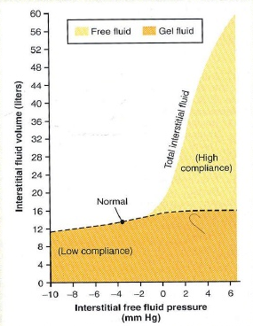
In negative pressure ranges
LOW compliance by presence of gel fluids results in relative increase in hydrostatic pressure to small changes in volume → prevents capillary filtration

Slide 9
In positive pressure ranges
HIGH compliance
by accumulation of free fluids results in smaller increase in hydrostatic pressure to high changes in volume → Pitting oedema

Slide 10
Safety factors for preventing oedema
Low tissue compliance
Increased lymph flow
Increased protein wash-down from interstitial fluids

Slide 11
Increased lymph flow as safety factor
Lymph flow can increase up to 10-50 folds
→ Carry away large amounts of fluids → prevents interstitial pressure from rising into POSITIVE ranges

Slide 12
Safety factors for preventing oedema
Low tissue compliance
Increased lymph flow
Increased protein wash-down from interstitial fluids

Slide 13
Increased lymph flow → increased Protein washout from interstitial fluids
Increased Lymph flow
→ Carry away large amounts of proteins (Protein washed out from interstitial fluids) → decrease Colloid osmotic pressure in interstitial fluid → Lowering net filtration forces → Prevents accumulation of fluids

