Slide 8
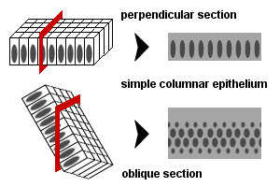

Slide 12
10 A

Slide 13
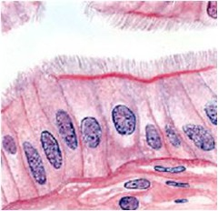
11 A

Slide 14
12 A

Slide 15
13 A

Slide 17
When we are going to identify the type of a gland we ask two questions :
1- is it simple or compound ? ( mainly when the gland has high number of secretory portions so there must be more than one duct . Also if we see more than one profile of ducts (simple cuboidal , simple columnar, stratified cuboidal ….. ) then the duct must be branched and we have a compound gland (but this case is unlikely to be in the exam ).
2- is it serrous or acinus ? ( serrous will be more likely acinus and mucous is more likely to be tubular)
Note : apocrine secretion :
1- mammary glands
2- ear glands which secrete waxy material
3- apocrine sweat glands like in axilla.
Holocrine secretion : sebacous glands.
Note : in acinar sections, just small number of glands have lumen .. Why?
Because we have to cut exactly in the middle of each secretory portion to catch the lumen.

Slide 18
1B

Slide 19
2B

Slide 20
Mammary gland
3B

Slide 21
4B

Slide 22
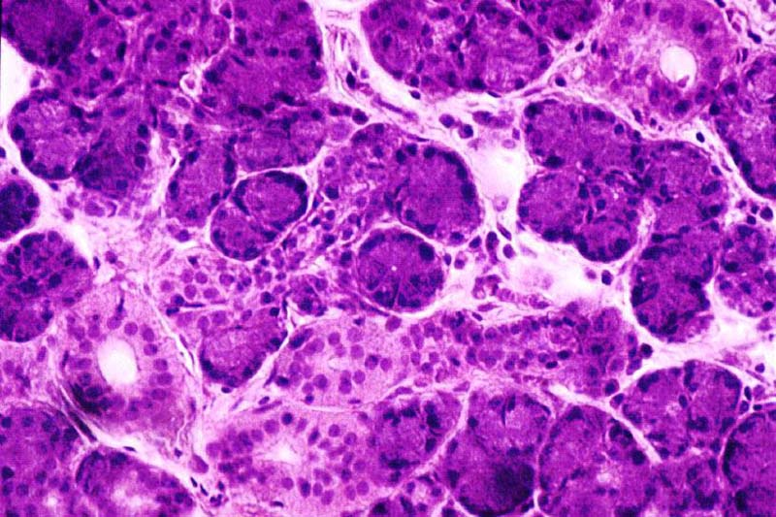
5B

Slide 23
PAS stain
6B

Slide 24
7B

Slide 25
8B

Slide 26
9B

Slide 27
10 B

Slide 28
Sebaceous glands:
Are classified as compound
tubulo-acinar glands. T/F
Have an apocrine mode of
secretion. T/F
Produce a mucous
secretion. T/F
May be associated with
hair
folicules.
T/F

Slide 29
Goblet Cells:
Are modified epithelial
cells. T/F
Secrete serous fluid.
T/F
Are found in respiratory
epithelia. T/F
Are multicellular glands.
T/F

Slide 30
The sublingual gland:
Is a simple branched alveolar gland. T/F
Is a mixed gland. T/F
Has a merocrine mode
of secretion. T/F
Has serous demilunes . T/F

