Slide 1
Thyroid gland
Gross anatomy

Slide 2
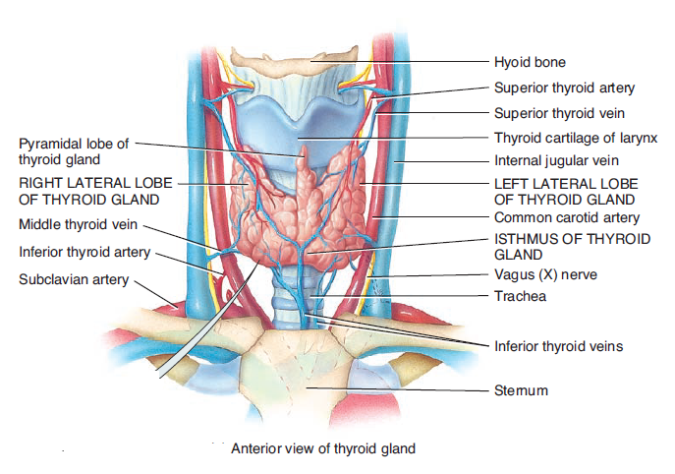
Location
Thyroid Gland
Located at the level of the C5-T1 vertebrae
The thyroid gland consists of right and left lobes connected
by
a narrow isthmus.
Each lobe is pear shaped, with its apex being directed upward as far as the oblique line on the lamina of the thyroid cartilage
its base lies below at the level of the fourth or fifth tracheal ring.
The isthmus extends across the midline in front of the second, third, and fourth tracheal rings
. A pyramidal lobe is often present, and it projects upward from the isthmus

Slide 3
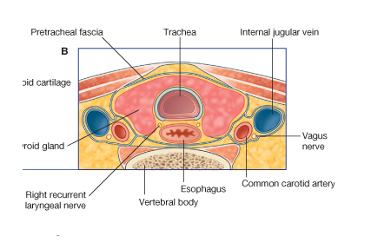
It is a vascular organ surrounded by a sheath derived from the pretracheal layer of deep fascia.
The sheath attaches the gland to the larynx and the trachea.
explains why the thyroid gland follows the movements of the larynx in swallowing.
This information is important because any pathologic neck swelling that is part of the
thyroid gland will move upward when the patient is asked to swallow

Slide 4
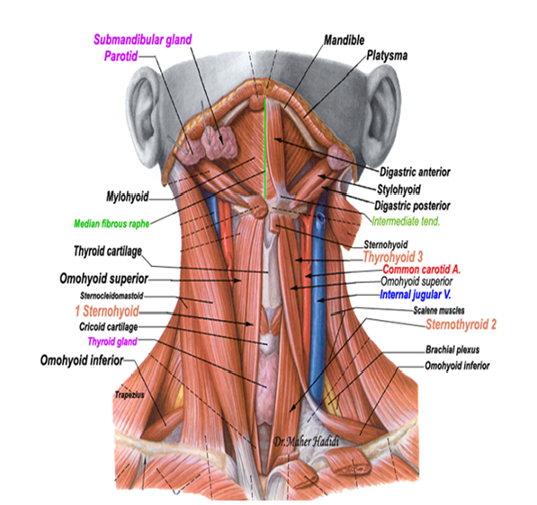
Relations of the Lobes
Anterolaterally
2-the superior belly of the omohyoid
3-The sternothyroid
1-The sternohyoid
4-the anterior border of the sternocleidomastoid

Slide 5
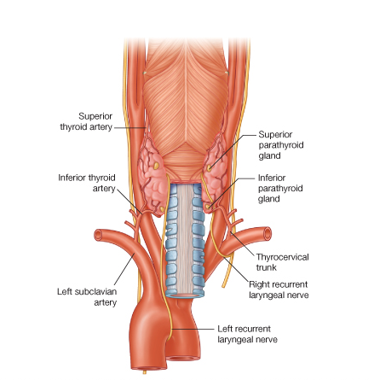
The rounded posterior border of each lobe is related posteriorly to
the superior and inferior parathyroid glands
and
The anastomosis between
the superior and inferior thyroid arteries.
Posterior view

Slide 6
Posterolaterally:
The carotid sheath with the common carotid artery, the internal jugular vein, and the vagus nerve
Medially:
The larynx, the trachea, the pharynx, and the esophagus. Associated with these structures are the cricothyroid muscle and its nerve supply, the external laryngeal nerve. In the groove between the esophagus and the trachea is the recurrent laryngeal nerve

Slide 7
Retrosternal Goiter
The attachment of the sternothyroid muscles to the thyroid
cartilage effectively binds down the thyroid gland to the larynx
limits upward expansion of the gland
However, downward expansion
has no limitation
Therefore:
IMPORTANAT
a pathologically enlarged thyroid gland
MAY
extend downward
behind the sternum.
A retrosternal goiter

Slide 8
any abnormal enlargement of the thyroid gland
can compress the
trachea and cause dangerous dyspnea;
it can also cause severe
venous compression.

Slide 9
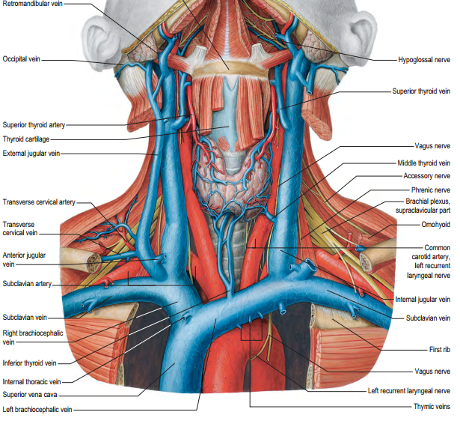
Blood Supply

Slide 10
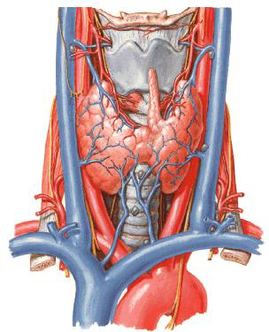
1-The superior thyroid artery
2-The inferior thyroid artery
3- Sometimes the thyroidea ima.
1-The superior thyroid artery, a branch of the external carotid artery, descends to the upper pole of each lobe, accompanied by the external laryngeal nerve

Slide 11
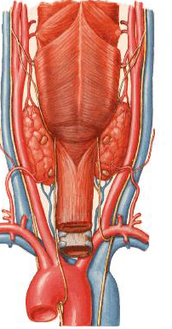
2-The inferior thyroid artery, a branch of the thyrocervical trunk, ascends behind the gland to the level of the cricoid cartilage. It then turns medially and downward to reach the posterior border of the gland.
The recurrent laryngeal nerve crosses either in front of or behind the artery, or it may pass between its branches.

Slide 12
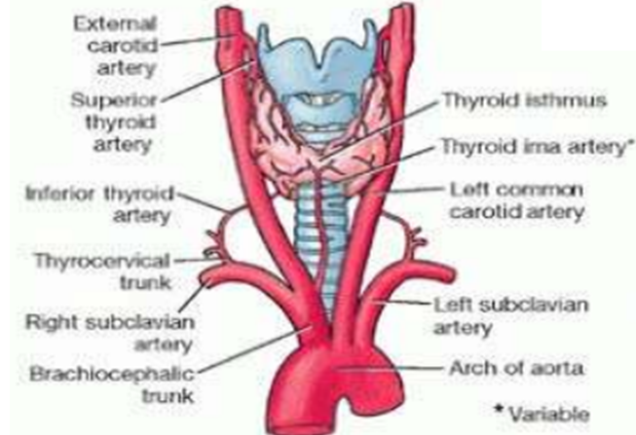
3-The thyroidea ima, In approximately 10% of people, a thyroid ima artery
arises from the brachiocephalic trunk,
the arch of the aorta,
from the right common carotid
subclavian, or internal thoracic arteries
ascends on the anterior surface of the trachea, which it supplies, and continues to the isthmus of the thyroid gland.
The possible presence of this artery must be considered when performing procedures in the midline of the neck inferior to the isthmus because it is a potential source of bleeding

Slide 13
The veins from the thyroid gland are the:
1-Superior thyroid
which drains into the internal jugular vein;
2-The middle thyroid
which drains into the internal jugular vein;
3-The inferior thyroid
The inferior thyroid veins of the two sides anastomose with one another as they descend in front of the trachea. They drain into the left brachiocephalic vein in the thorax

Slide 14
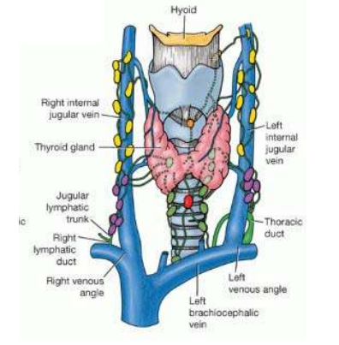
The lymphatic vessels of the thyroid gland communicate with a capsular network of lymphatic vessels.
From this network, the vessels pass initially to prelaryngeal, pretracheal, and paratracheal lymph nodes, which drain in turn to the superior and inferior deep cervical nodes Inferior to the thyroid gland, the lymphatic vessels pass directly to the inferior deep cervical lymph nodes. Some lymphatic vessels may drain into brachiocephalic lymph nodes or the thoracic duct.

Slide 15
Lesions of the Laryngeal Nerves
The muscles of the larynx are innervated by the recurrent laryngeal nerves, with the exception of the cricothyroid muscle, which is supplied by the external laryngeal nerve. Both these nerves are vulnerable during operations on the thyroid gland because of the close relationship between them and the arteries of the gland.
It should be remembered that the two main arteries supplying
the thyroid gland are closely related to important nerves
that can be damaged during thyroidectomy operations
To be discussed next year

Slide 16
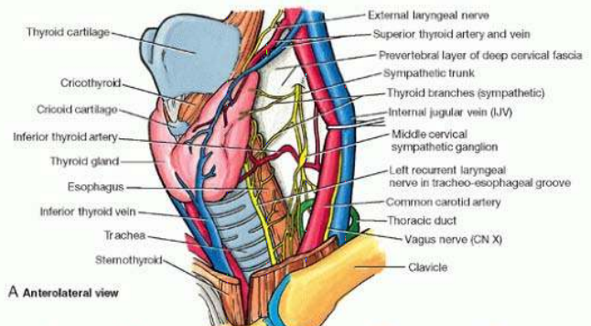
The superior thyroid artery on each side is related
to the external laryngeal nerve, which supplies the
cricothyroid muscle.
Damage to the external laryngeal nerve
results in an inability to tense the vocal folds and in hoarseness

Slide 17
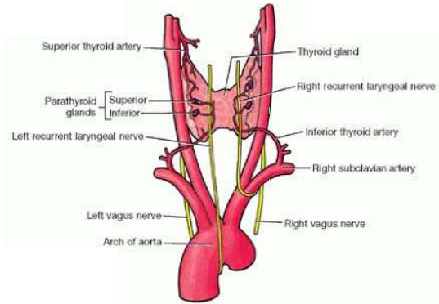
The terminal branches of the inferior
thyroid artery
on each side are related to the
RECURRENT LARYNGEAL NERVE.

Slide 18
Embryology

Slide 19
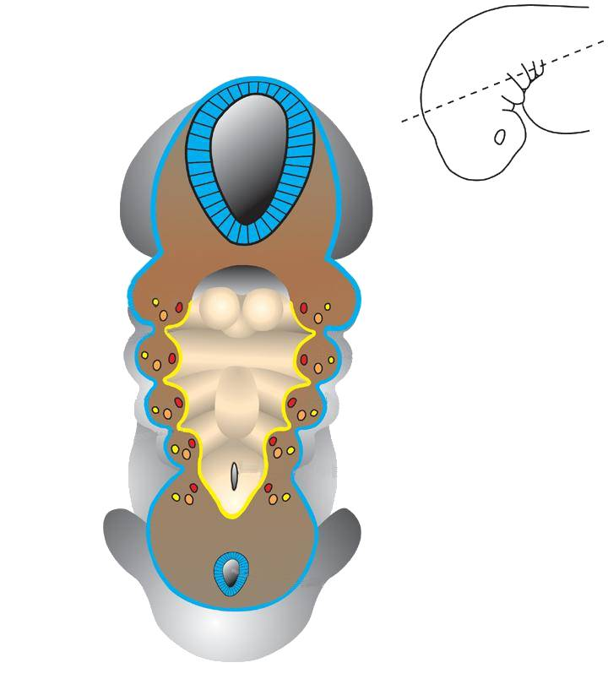
In a cross section of the embryo in the area of the head and neck
The following can be noticed
THE PHARYNGEAL ARCHES
THE PHARYNGEAL ARCHES
are separated
by deep clefts known as
PHARYNGEAL CLEFTS
Read only
with development of the arches and clefts,
a number of outpocketings,
The pharyngeal pouches appear

Slide 20
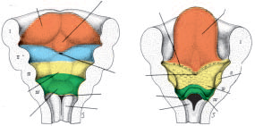
Tuberculum impar
Terminal sulcus
Lateral lingual swelling
in the floor of the pharynx
Palatine
tonsil
Foramen
cecum
Copula
(hypobranchial
eminence
Root of
tongue
Epiglottal
swelling

Slide 21
1-As the lateral lingual swellings increase in size, they overgrow the tuberculum
impar and merge, forming the anterior two-thirds, or body, of the tongue
Since the mucosa covering the body of the tongue originates
from the first pharyngeal arch, sensory innervation to this area is by
the mandibular branch of the trigeminal nerve.
The body of the tongue is
separated from the posterior third by a V-shaped groove,
the terminal sulcus
2-The posterior part, or root, of the tongue originates from the second, third,
and part of the fourth pharyngeal arch
The fact that sensory innervation to
this part of the tongue is supplied by the glossopharyngeal nerve indicates that
tissue of the third arch overgrows that of the second.
Some of the tongue muscles probably differentiate in situ, but most are
derived from myoblasts originating in occipital somites.
Thus, tongue musculature
is innervated by the hypoglossal nerve.

Slide 22
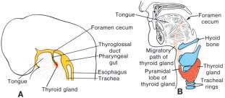
Thyroid Gland
begins to develop during the third week as an endodermal thickening in the floor of the pharynx
between the tuberculum impar and the copula at a point later indicated
by the foramen cecum
descends in front of the pharyngeal gut as a bilobed diverticulum
During this migration, the thyroid remains connected to the tongue by a narrow
canal, the thyroglossal duct. This duct later disappears.

Slide 23
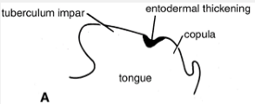
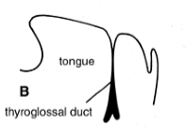
Later, this thickening becomes a diverticulum that grows inferiorly into the underlying mesenchyme and is called
the thyroglossal duct

Slide 24
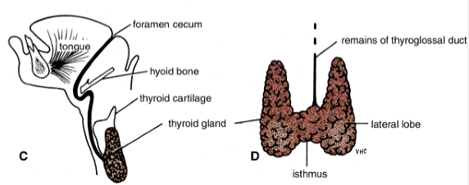
As development continues, the duct elongates, and its distal end becomes bilobed. Soon, the duct becomes a solid cord of cells, and as a result of epithelial proliferation, the bilobed terminal swellings expand to form the thyroid gland
The thyroid gland now migrates inferiorly in the neck and passes either anterior to, posterior to, or through the developing body of the hyoid bone. By the seventh week, it reaches its final position in relation to the larynx and trachea. Meanwhile, the solid cord connecting the thyroid gland to the tongue fragments and disappears. The site of origin of the thyroglossal duct on the tongue remains as a pit called the foramen cecum. The thyroid gland may now be divided into a small median isthmus and two large lateral lobes

Slide 25
The ultimobranchial bodies (from the fifth pharyngeal pouch) and neural crest cells are believed to be incorporated into the thyroid gland, where they form the parafollicular cells, which produce calcitonin.

Slide 26
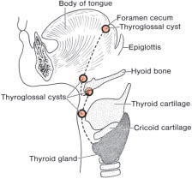
Thyroglossal Duct and Thyroid Abnormalities
A thyroglossal cyst may lie at any point along the migratory pathway of the
thyroid gland but is always near or in the midline of the neck
by its name, it is a cystic remnant of the thyroglossal duct, Although approximately
50% of these cysts are close to or just inferior to the body of the hyoid
bone they may also be found at the base of the tongue
or close to the thyroid cartilage. Sometimes a thyroglossal cyst is connected to
the outside by a fistulous canal, a thyroglossal fistula. Such a fistula usually
arises secondarily after rupture of a cyst but may be present at birth.

Slide 27
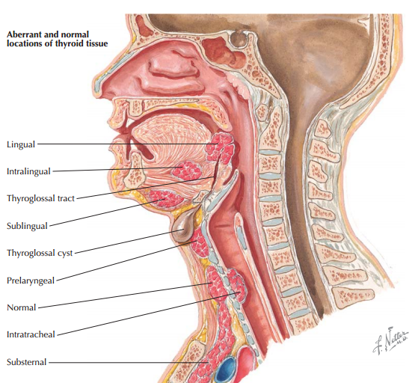
Thyroglossal Duct and Thyroid Abnormalities

Slide 28
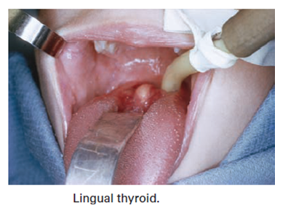
Congenital Anomalies of the
Thyroid Gland
Agenesis of the Thyroid
Failure of development of the thyroid gland may occur and
is the commonest cause of cretinism
Incomplete Descent of the Thyroid
The descent of the thyroid may be arrested at any point
between the base of the tongue and the trachea
Lingual thyroid is the most common form of incomplete
descent The mass of tissue
Persistent Thyroglossal Duct
Conditions related to a persistence of the thyroglossal duct
usually appear in childhood, in adolescence, or in young
adulthood

Slide 29
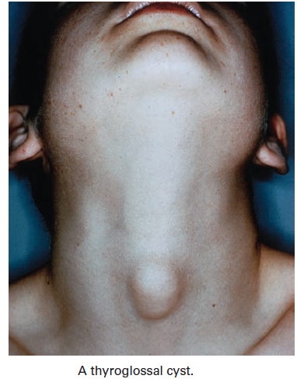
Thyroglossal Sinus (Fistula)
Occasionally, a thyroglossal cyst ruptures spontaneously,
producing a sinus). Usually, this is a result of an infection of a cyst. All remnants of the thyroglossal
duct should be removed surgically

Slide 30
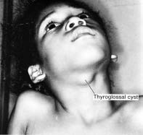
Thyroglossal cyst. These cysts, which are remnants of the thyroglossal
duct, may be anywhere along the migration pathway of the thyroid gland. They are commonly
found behind the arch of the hyoid bone. An important diagnostic characteristic
is their midline location.

Slide 31
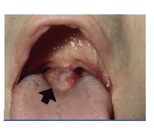
Aberrant thyroid tissue may be found anywhere along the path of descent
of the thyroid gland. It is commonly found in the base of the tongue,
just behind the foramen cecum, and is subject to the same diseases as the
thyroid gland itself.
caution!!!
A mass in the posterior midline might be the only thyroid in the patient’s body

Slide 32
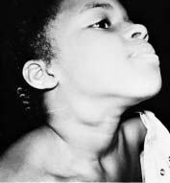
Branchial Fistulas
lateral cervical
cyst
Branchial fistulas occur when the second pharyngeal arch fails to grow caudally
over the third and fourth arches, leaving remnants of the second, third,
and fourth clefts in contact with the surface by a narrow canal.
Such a fistula, found on the lateral aspect of the neck directly anterior to the sternocleidomastoid muscle, usually provides drainage for a lateral cervical
cyst These cysts, remnants of the cervical sinus, are most often
just below the angle of the jaw
Frequently a lateral cervical cyst is not visible at birth but becomes evident as it
enlarges during childhood.
Patient with a lateral cervical cyst. These cysts are always on the lateral
side of the neck in front of the sternocleidomastoid muscle. They commonly lie under
the angle of the mandible and do not enlarge until later in life.

Slide 33
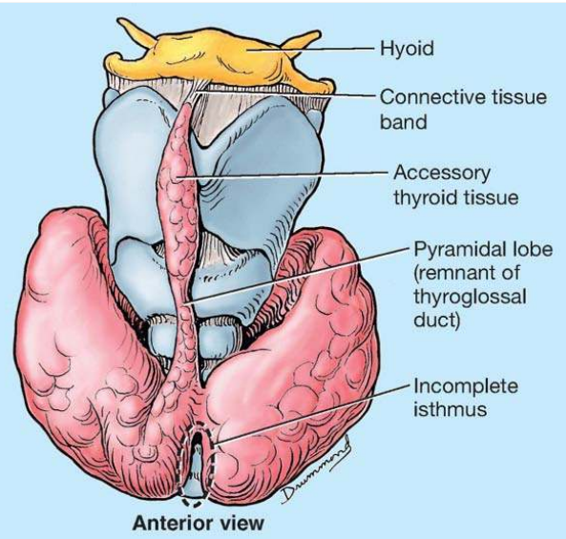
Accessory Thyroid Tissue

Slide 34
Radiology

Slide 35
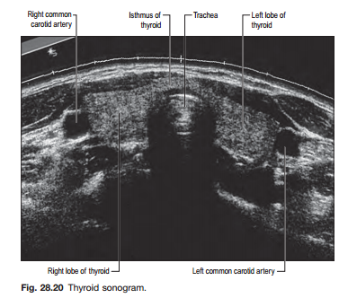

Slide 36
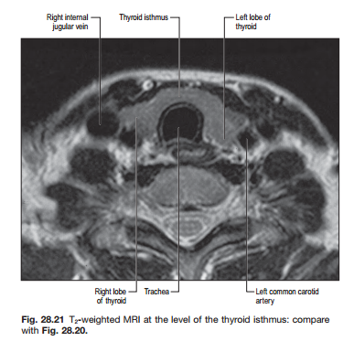

Slide 37
